Slide 1
Movie Review &Recommendation App
A00232428

Slide 2

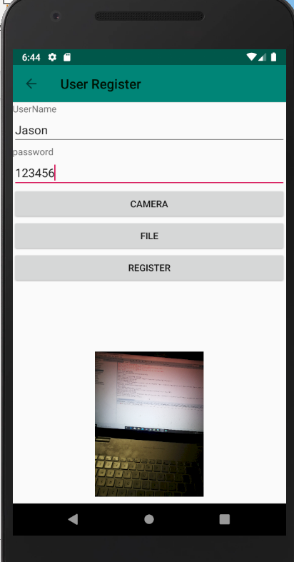
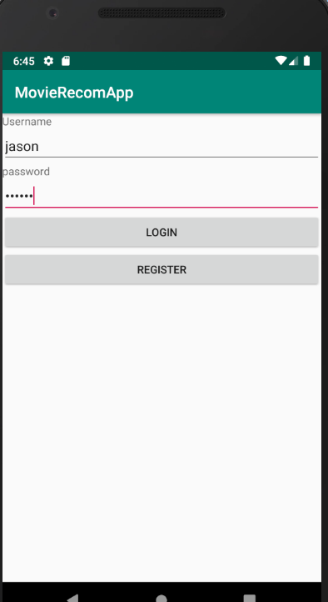
Create user Jason that is not exist in the system.
The Profile pic can be get from file in the phone storage or camera

Slide 3
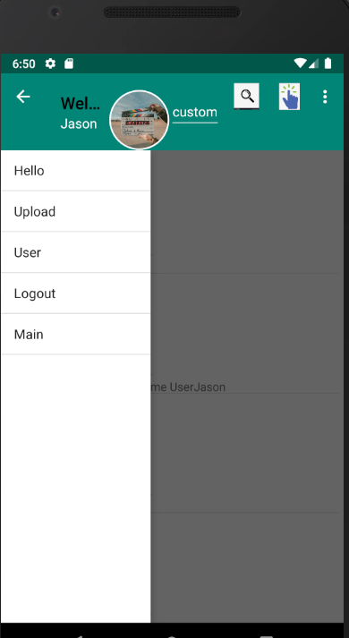
This is the homepage that show the details of movie reviews in the list view.
The Left handside is drawer layout that switch to other activity’s
The top is toolbar that display the username and profile picture.
Also with the search button that search the recommendation has same movie name or uploader to the text in the textfiled

Slide 4
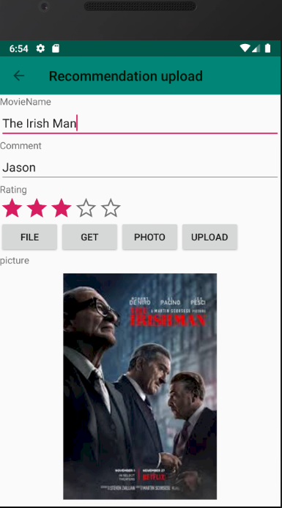
User can upload the movie reviews by fill the informations.
The ratingBar are used to rate the movies.
To get the Picture will be same process as profile picture

Slide 5
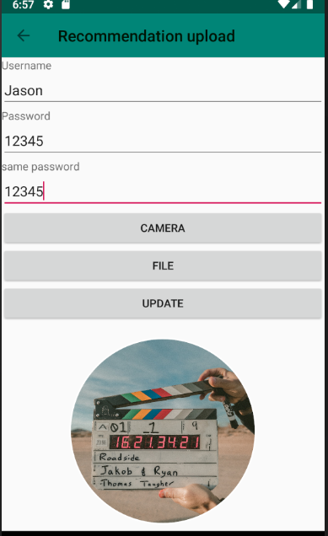
Update function can modify User’s password and profile pictures.

Slide 6
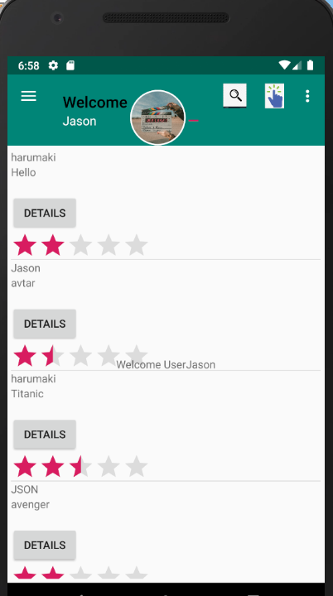
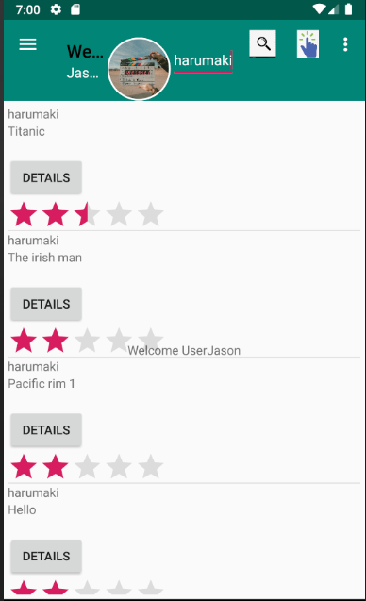
The movie review create by other user are display in the list view.
User can find the review base on movie name or uploader by insert the text in toolbar.

Slide 7
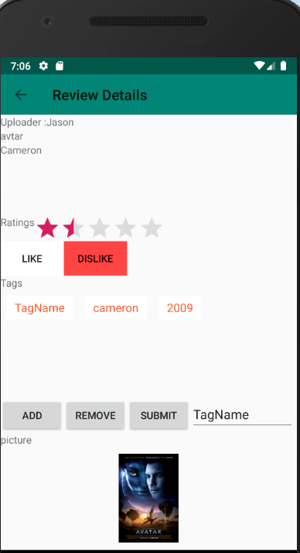
This is the page with details of clicked movie review.
The like and dislike button are clicked to assume the user either like or dislike this movie or uploader.
User can cancel their like or dislike by click the button again, this will delete from database.
User can create tag by add the text in filed and click the tag that want to add to the system.
The tag name can be duplicate .it will order the tag list by the time of that tag been add by user

Slide 8
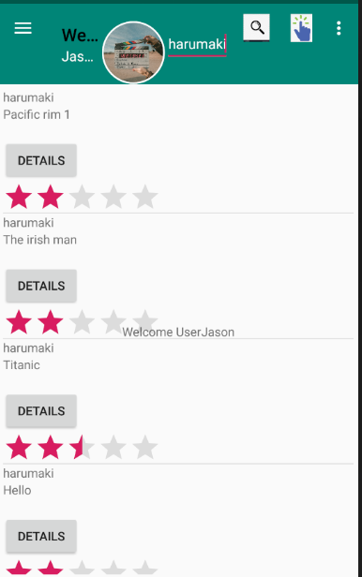
The idea of recommend movie review is base on the Userpreference (Content-base filtering)
This can be done when user Click like or dislike the review ,the userPreference store to database with rating 1 or -1 and recommendation infos.
The function calculate_sum is use to sum the total rating of the movie name and uploader .
For the higher rating means user are more interest in this preference.
Thus the recommendation list are order base on the sum rating.

